Slide 1

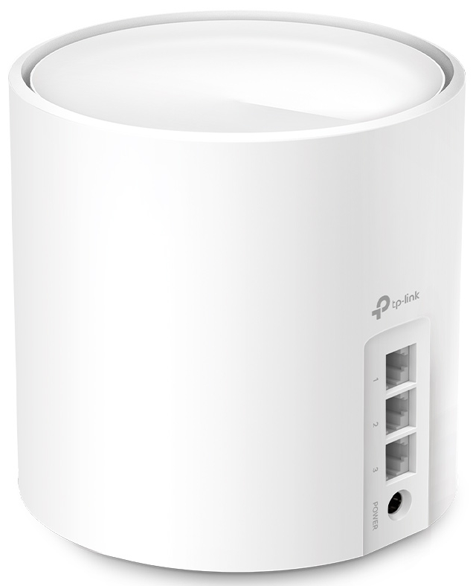
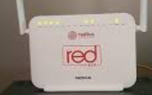


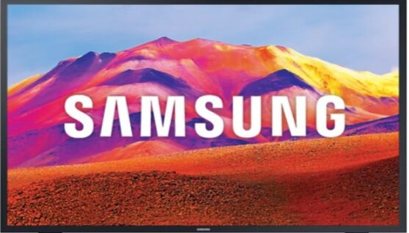
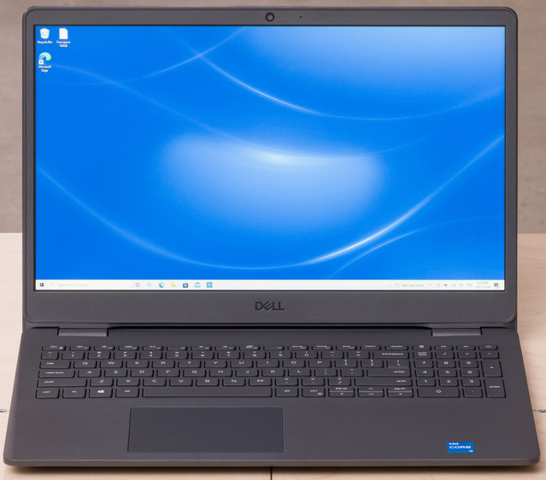
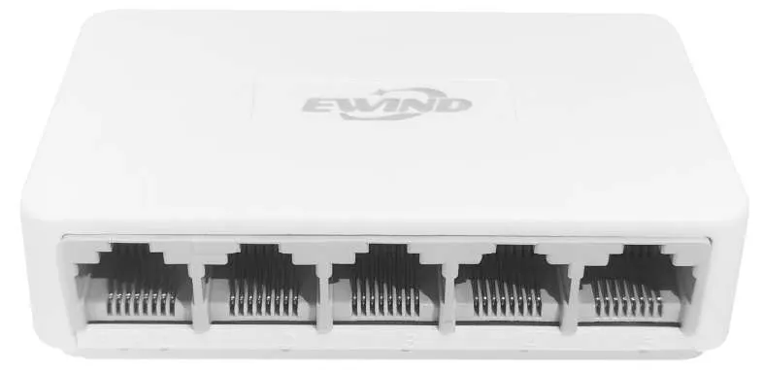
Deco X50
・IoT Wifi - Alexa
- Smart Home Devices
・Wifi - Personal Mobile Phone
・Guest Wifi - Guest Mobile Phones
Reserve

